Slide 1
Training of trainers
S7
By the end of this session you should be able to: - Revise and adapt training materials to country needs - Apply a participative training approach - Evaluate participants & recommend post-training actions
Notes:
Facilitators notes:
Time: 30 minutes
Materials: Slide deck adapted to country context
Preparation:
Ensure there is an internet connection, or that you have downloaded video clips embedded in the training deck
Set up sound connection to laptop for training video
Ensure you have adapted the slides to reflect the blood-stage treatment used in your country, and understand the time to relapse for p vivax in your region

Slide 2
Training preparation – Adapting training materials 1
S7
Adapting training materials
Country treatment strategy or proposed strategy Training sessions have been tailored to two scenarios:
Introduction of the quantitative G6PD test used with primaquine and,
Both the Qn-G6PD test and Tafenoquine are introduced simultaneously
Country context These training materials will have most impact when adapted with and by in-country partners who can provide context specific detail on how the materials should reflect the health system, delivery of training, supervision of Health workers.
Messages around adherence to PQ should be tailored to the context in collaboration with Behaviour Change Communication specialists in-country
Frameworks for thinking about AHA and clinical management need to be adapted with clinicians from the country using these materials to properly reflect current treatment practice for AHA
Specific sessions could be included into broader malaria diagnostic training that is already planned in-country.
While materials are currently tailored to different cadre of health workers, these need to be adapted to the health system in-country.

Slide 3
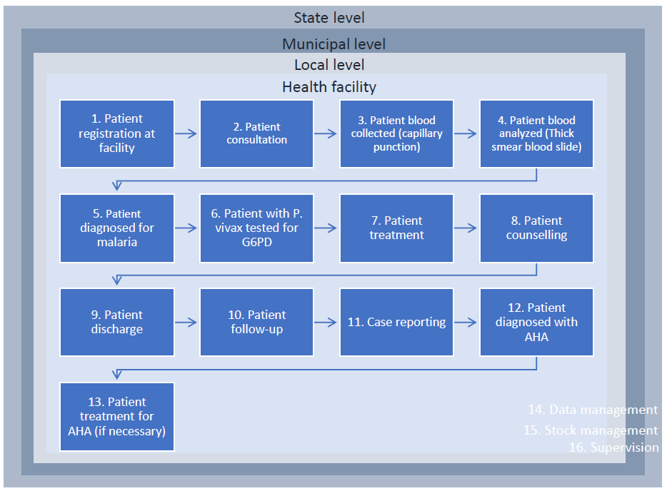
Training preparation - Adapting training materials 2
S7
Participant profiles
At what level of the health system are new tools being introduced?
What type of health professional being trained?
For what parts of the patient pathway is the health worker responsible?

Slide 4
Training preparation - Training sessions
S7
Introduction session
Session 1: What is Plasmodium vivax malaria & Glucose-6-Phosphate Dehydrogenase (G6PD) deficiency?
Session 2.1: How to perform Qn-G6PD test part 1 – Theory
Session 2 (controls): How to run Qn-G6PD controls_Pt1 – Theory
Session 2 (venous): How to do the Qn-G6PD test with venous blood_Pt1 – Theory
Session 2.2: How to perform Qn-G6PD test part 2 – Practical
Session 3.1: How to treat P. vivax malaria parts 1 & 2 (Primaquine) & mini-scenarios
Session 3.2: How to treat P. vivax malaria parts 1 & 2 (Primaquine and Tafenoquine)
Session 4: Risk minimization & patient counselling
Session 5: Identification & reporting Acute Haemolytic Anaemia (AHA)
Session 6: Introducing new tools into your facility & role-play scenarios
Wrap up session

Slide 5
Example agendas – [Country]
S7
Country treatment strategy
NMCP in the country of Meath aim to roll out Quantitative-G6PD + PQ14 to community level
Roll out of Quantitative-G6PD starting at higher level facilities and extending to community level once access strategy identified through Feasibility Studies (FS)
Country context
Variable G6PD deficiency reported (8 – 31%)
Clustered vivax caseload in specific sub-national (adm 3) areas classified by NMCP as ‘hotspots’
Overlap between suspected high prevalence G6PDd areas + vivax hotspots
Programme externally funded through Global Fund with budget allocated for Qn-G6PD analyzers and test devices

Slide 6
Example agendas – [Country]
S7
Participant profile & training needs
Participant profile | Role in Px pathway | Suggestion training session
Hospital or higher level facility GP, infectious disease experts or doctors | Interprets G6PD results to prescribe malaria treatment, counsels patient on treatment course | 8 sessions: Introduction, S1, S2.1, S3.1, S4, S5, S6, wrap-up session
Nurses at national or sub-national hospitals (facilities with in-patient care) | Sometimes tests patients for malaria & G6PD. Mainly interprets G6PD results to prescribe malaria treatment, counsels patient on treatment course | 8 sessions: Introduction, S1, S2.1, S3.1, S4, S5, S6, wrap-up session
Laboratory technicians | Tests patients for malaria & G6PD. Refers patient to doctor or nurse for treatment | 6 sessions: Introduction, S1, S2.1 & S2.2 including venous and controls), S6, wrap-up session
Lower level health facilities nursing aids, midwives (primary health care facilities) + community volunteers | Often tests patients for malaria & G6PD, interprets test results, prescribes and administers treatment for malaria | 10 sessions: Introduction, S1, S2.1 & S2.2, S3.1 & S3.2, S4, S5, S6, wrap-up session

Slide 7
Example agenda – [Country]
S7
Training agenda 1: Laboratory technicians
Session # | Session title | Time
Intro | Introductions and overview of agenda | 45 mins
S1 | What is P. vivax malaria & G6PD? | 30 mins
S2.1 | Quantitative-G6PD part 1 – Theory (including venous blood & controls) | 45 mins
S2.2 | Quantitative-G6PD part 2 – Practical | 90 mins
S6 | Introducing new tools in health facilities | 30 mins
Wrap | Wrap-up session | 10 mins
Quiz2 | Post-training competency test | 45 mins
 | Total session time (approx.) | 5 hours

Slide 8
Example agenda – [Country]
S7
Training agenda 2: Lower level health facilities
Session # | Session title | Time
Intro | Introductions and overview of agenda | 45 mins
SQ1 | Pre-training quiz | 45 mins
S1 | What is P. vivax malaria & G6PD? | 30 mins
S2.1 | Quantitative-G6PD part 1 – Theory | 45 mins
S2.2 | Quantitative-G6PD part 2 – Practical (including competency testing) | 120 mins
S3.1 | Treatment with PQ | 60 mins
S3.2 | Mini-scenarios & role plays | 45 mins
S4 | Risk minimization & patient counselling | 30 mins
S5 | Identification and reporting of AHA | 45 mins
S6 | Introducing new tools in health facilities & role-plays | 70 mins
Wrap | Wrap-up session | 10 mins
Quiz2 | Post-training evaluation | 45 mins
 | Total session time (approx.) | 2 days

Slide 9
Training approach
S7
Participative training
The overall training approach should be one that encourages active learning and participation. Room layout should facilitate participation, either having people sit in clusters or groups or in a large circle (if writing seats are available).
Below are guidelines that can be followed to ensure a participative approach is followed:
Reiterate throughout the training that participants should feel free to ask questions and share their experiences at any time
Always treat all the participants with respect irrespective of culture, age, or gender.
Secure and respect confidentiality to allow facilitators and participants discuss issues without fear of negative consequences
Seek expert opinion of both facilitators and participants throughout training
Commit to critical appraisal of your activities and respect of criticism to make the fairness of your decisions evident
From the very beginning determine how facilitators and invited specialists will cooperate and voice their opinions – both positive and negative – and how to keep each other within the context of the programme.

Slide 10
Training preparation - Training
S7
Training facilitation
Identification of trainers
Trainers or facilitators should be experts from the National programme and those from related departments implicated in the use of the new tools
Experts from other departments should include; the department that oversees medical services/hospitals, FDA/pharmacovigilance units and surveillance units
Trainer preparation
Once the core group of trainers or facilitators are identified, they should be included in the adaptation of training materials
Trainers should read through all generic materials, including facilitators notes under each slide
Practice sessions with the G6PD analyzers should be organised before full training begin to give facilitators the opportunity to familiarise themselves with the analyzers, test devices, controls alongside training materials
Trainers should also practice role-play set up and read-through and understand the mini-scenarios
Trainer roles
Trainers should support each other in time-keeping during different sessions
Trainers that are not presenting should take notes during the training when participants are providing feedback and participating in training sessions
All trainers should contribute to the training report, ensuring that notes taken during sessions are included

Slide 11
Training preparation – slide & session structures
S7
Slides & slide notes
Trainers should go through slides in detail prior to training noting where changes need to be made to their context
Particular attention should be given to the slide notes in which there is an overview of the timing for each session, prompts to encourage participation and background detail on the content of the slide as well as instructions for role plays and groupwork
Practical sessions
Trainers need to ensure materials for practical sessions are ready and set up ahead of training.
Materials required for each session are listed in the slide notes for practical's
Role-plays & mini-scenarios
Trainers need to read through mini-scenarios to ensure they are adapted to their country context
Role-play materials should be prepared in advance of the training.
Trainers should discuss how they will share learnings from the role-plays

Slide 12
Ensuring training quality
S7
Numbers of participants & ratio of trainers: participants
Level of health system | Type of health professional | Max # of participants | Ratio of trainers to participants
Hospital level | Medical physicians, general practitioners, infectious disease specialists | 35 | 1:15
Sub-national level in-patient facilities | Nurses, nurse practitioners, laboratory technicians | 30 | 1:8 or 1:10
Primary health care facilities | Nursing assistants | 25 | 1:7
Community level | Volunteers | 20 | 1:5
Ensure an adequate ratio of G6PD analysers to trainees: 2 to 4 trainees per device
Notes:
Notes:
Smaller number of participants or more facilitators may not always be feasible. In cases where there are not enough faciltiators, the number of participants should be capped to those suggested here if possible.

Slide 13
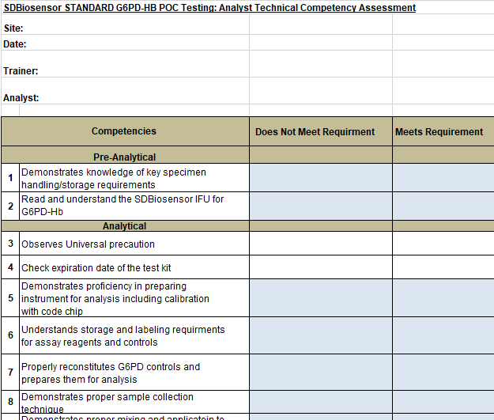
Ensuring training quality – G6PD competency evaluations
S7
G6PD competency evaluation should be carried out for every participant undertaking the G6PD practical sessions
Competency testing is best undertaken at the end of practical sessions by 1-2 trainers
Focus the competency assessment on the practical aspects of G6PD testing. Cover the theoretical aspects such as interpretation in the pre/post test.
The competency assessment should be completed for each participant
If participants score low or medium marks in the competency assessment, further training should be arranged immediately before G6PD analyzers are distributed to their facilities

Slide 14
Ensuring training quality
S7
Participants with low post-training quiz and/or G6PD device competency scores
No new tools should be introduced into facilities where health workers have scored low on post-training quizzes or tests
Post-training quiz and G6PD competency scores should be marked immediately after training has taken place
The pass mark for this training is 85%
For participants who scored above 85 – 99% trainers should go through their evaluations to highlight correct answers
For participants who score <85% retraining should be re-organised within 4 weeks of initial training.

Slide 15
Training report structure
S7
The following should be captured in your training report –
1. Participant profiles
In-service training
Recent refresher training on malaria case management
Number of years of experience since in-service training
Level of health facility at which participants work
Job responsibilities of participants
2. Number of trainers
3. Participative sessions & participant FAQs
Notes from any participative sessions where there was feedback on questions asked by trainers
Any questions that participants frequently asked during the training session
4. Pre & post evaluation results
Highlighting any questions that many participants failed to answer correctly
Including a table with participants by marking category
With an action plan as to post-evaluation follow up for poor and intermediate scored participants
Notes:
Trainer notes:
In terms of participant profiles, we are interested to understand their profiles and remit relative to slide number 3

Slide 16
Training feedback
S7
Post-training reports could also help us to improve these training materials.
Where possible, please provide feedback on the training materials and discussions or challenges that participants faced during training.
Feedback can be provided to: XXXXXXXX

